Slide 1
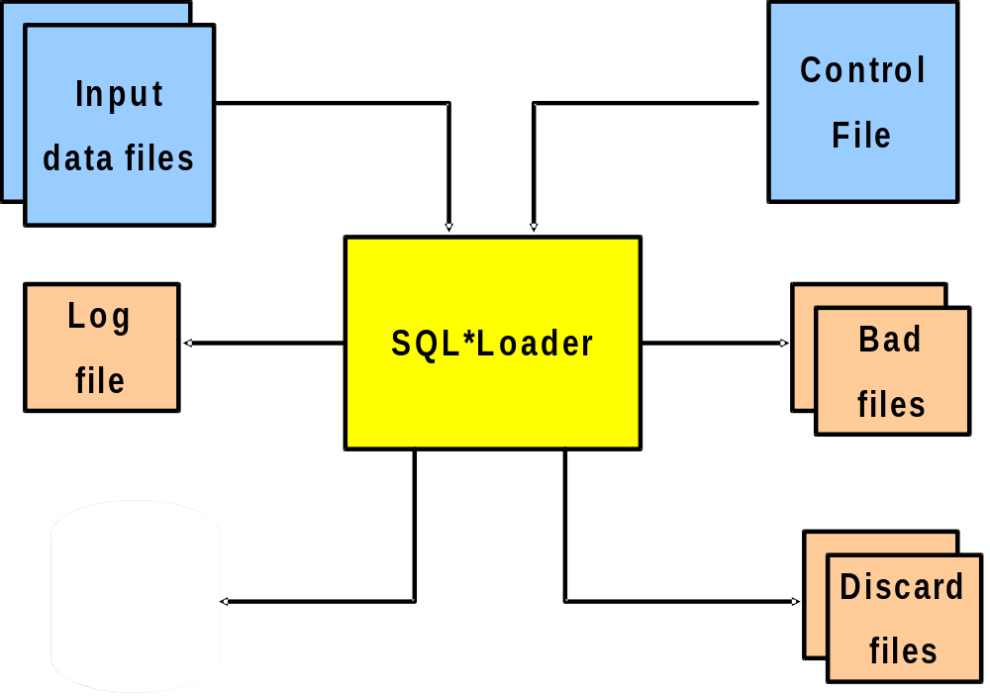

Slide 2
Log File log file contains a detailed summary of the load, including a description of any errors that occurred during the load
Bad File Bad file contain the records, which are rejected by the SQL*loader. when ever the Flat file format is not correct or if any internal error occurs
Discard File Discard file contains the records which are rejected by the control file

